Slide 1
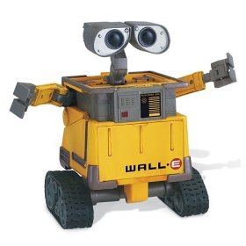
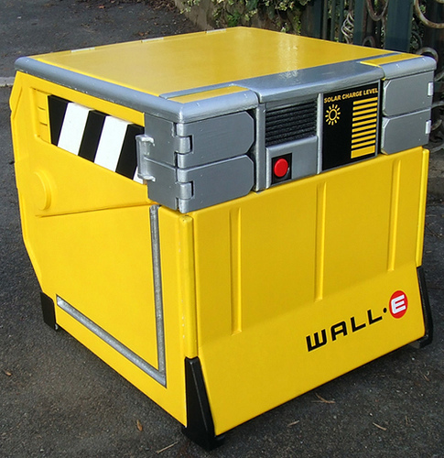

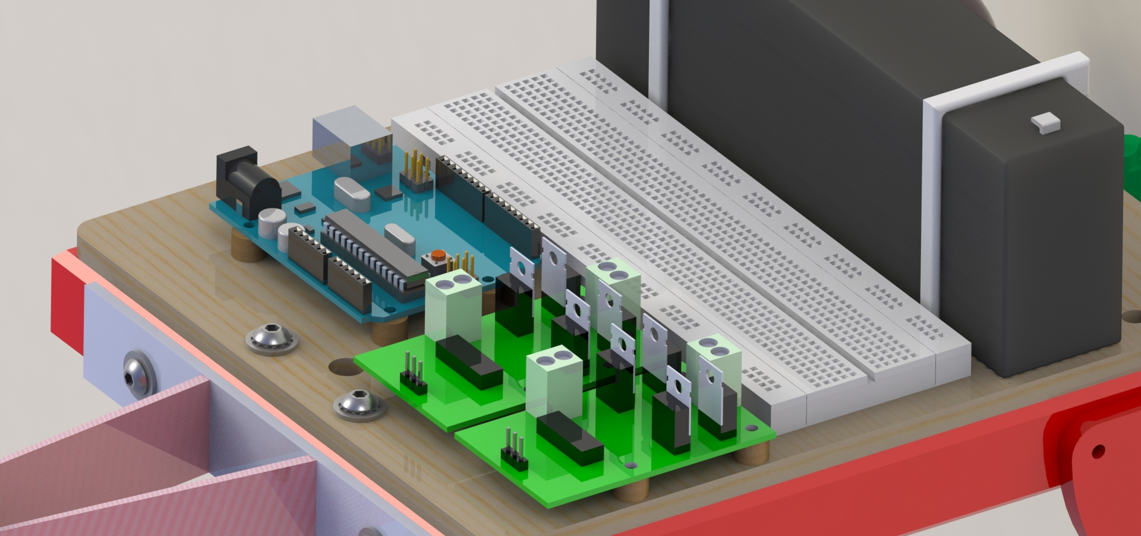
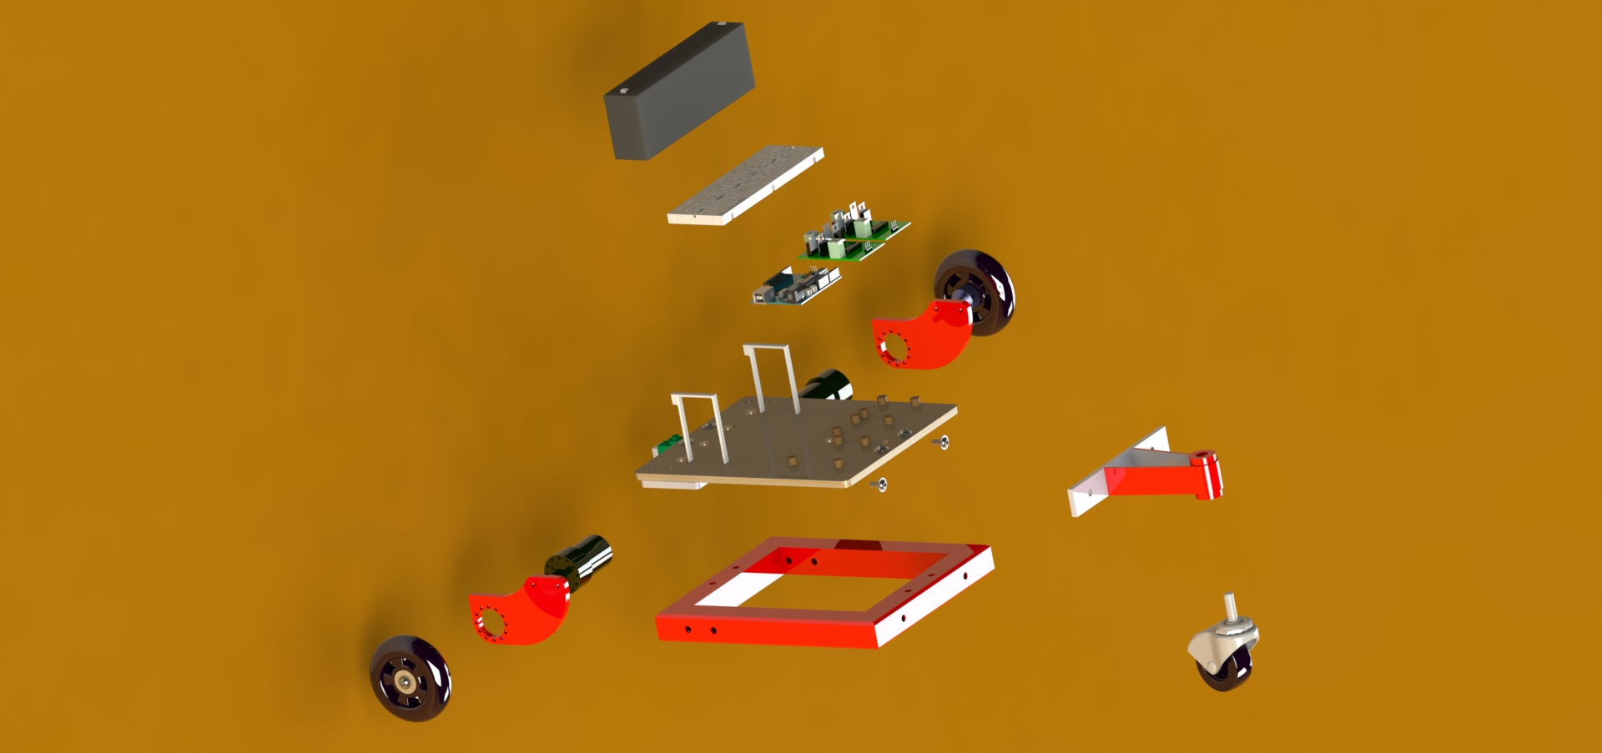
Manufacturing Process:
Create Preliminary design on Solidworks
Fabricate Parts in welding & Machine shop
Assemble mechanical & electrical components for a complete robotic assembly
Configure Programming
Sketch Chassis Design & create Solidworks/AutoCAD design
Laser-Cut Chassis components & Assembly
Complete Assembly
Bill of Materials
Total Cost: $477.42
Mechanical components comprised the bulk of costs on the BOM. This was due to sheer number of mechanical components & the added cost of buying small components & raw materials in bulk.
Chassis Cost in relation to other costs was negligible at $31.92 (6.69% of total cost). This outcome is sensible considering the simplicity of chassis design and quality of materials used. Future renditions of chassis concept will require more expensive materials and manufacturing processes ( i.e. sheet metal, laser-etched aluminum).

